Slide 1
Gel Retardation

Slide 2
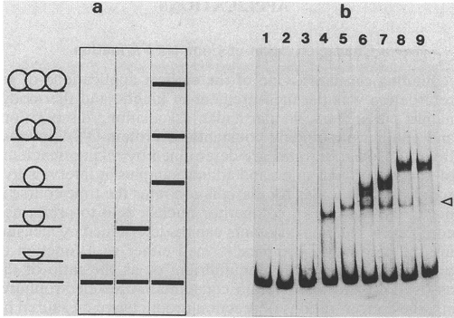
Effect of protein mass on retardation

Slide 3
Reporter Gene

Slide 4
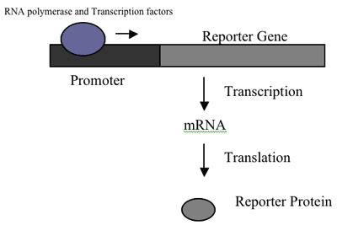
Background
http://www.clas.ufl.edu/jur/200611/papers/paper_rios.html

Slide 5
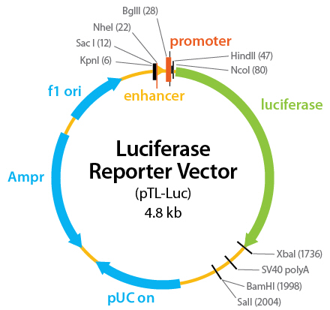
Reporter Construct
The Luciferase Reporter Vectors have been specially constructed to report the binding activity of a single TF. Multiple copies of the cis-acting enhancer element have been inserted into each vector upstream of a minimal TA promoter and the TATA box from the Herpes simplex virus thymidine kinase promoter. This promoter sequence drives expression of the luciferase gene (luc). The backbone of the vector contains an ampicillin resistance gene for cloning purposes, an origin of replication, and an f1 origin for single-stranded DNA production.
http://www.panomics.com/index.php?id=product_44

Slide 6
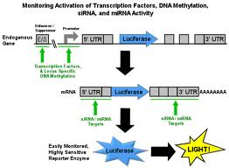
http://www.xactagen.com/

Slide 7
http://www.biij.org/2006/2/e8/

Slide 8
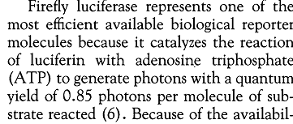

Slide 9
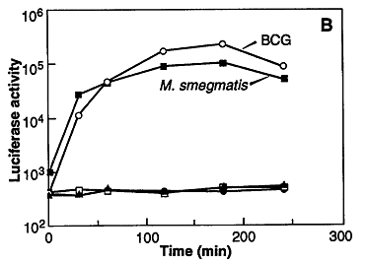

Slide 10
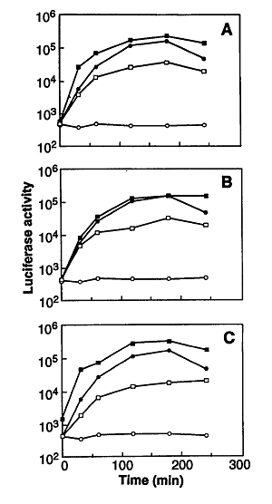
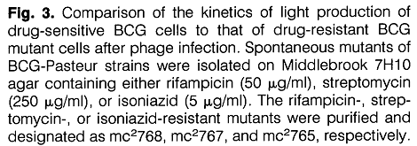

Slide 11
